Slide 1


Developing Collaborative Filtering Recommendation Systems for Amazon Movies and TV
By: Joshua Dytko

Slide 2
Introduction
The purpose of this project is to create a recommendation system for the Movies and TV categories Amazon dataset. Recommendation systems are valuable tools for companies that can provide many benefits when they are accurate and implemented well. Those benefits include:
Improved customer experience and retention
Improved revenue
Better reporting on the business
Increased traffic

Slide 3
Problem Identification
Challenge: Help customers discover relevant movies and TV shows in Amazons vast catalog
Objective: Develop a recommendation model that can provide personalized suggestions for each customer
Goal: Enhance customer experience by recommending them items they will find relevant and have interest in purchasing

Slide 4

Data Overview
Source: Public Amazon review datasets by UC San Diego researchers
Details and Key Features:
5-Core Movies and TV Category – All users and items in the dataset have at least 5 reviews
3,410,019 reviews
297,259 users
60,175 unique moves and tv shows
Timeframe: May 1996 – October 2018

Slide 5
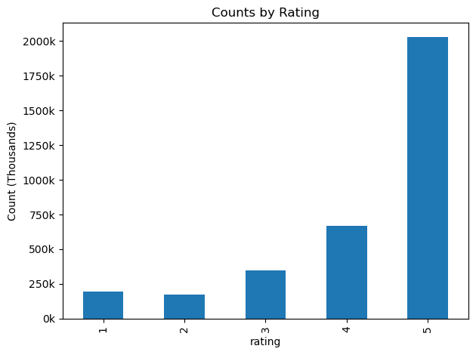
EDA
Rating Distribution:
Majority are 5-star reviews
Skewed towards higher ratings
User Behavior:
Active users tend to give higher average ratings
Insights:
Positive user experiences dominate
Potential bias towards favorable ratings

Slide 6
Data Preprocessing
Data Type Conversions:
Converted user_id and asin to strings
Ratings converted to float values
ID Mapping
Assigned unique integer indices to user_id and asin
Train-Test Split:
Dataset split in training (80%) and testing (20%) sets
Guaranteed that all users and items appeared in both sets
Data Integrity
There were no missing values and no duplicates in the dataset

Slide 7
Models
K-Nearest Neighbors (KNN):
Captures item similarities based on user-item interactions
Singular Value Decomposition (SVD):
Identifies latent factors influencing preferences
Alternating Least Squares (ALS):
Scalable for large datasets
Ensemble Model:
Combines KNN and SVD models
Weights based on inverse RMSE

Slide 8
Libraries Used
Surprise Library:
Used to create the KNN and SVD models
Comes with ready-to-use algorithms for collaborative filtering systems
PySpark:
Used to create the ALS model
Efficient and scalable for large datasets

Slide 9
Model Performance Metrics
RMSE (Root Mean Squared Error):
Measures the accuracy of predictions
Precision@10:
Proportion of the top 10 recommendations that are relevant
Recall@10:
Proportion of total Relevant items recommended in the top 10
F1 Score@10:
Harmonic mean of precision and recall

Slide 10
Model Performance Results
Model | RMSE | Precision@10 | Recall@10 | F1Score@10
KNN | 0.922 | 0.2037 | 0.9094 | 0.3329
SVD | 0.623 | 0.2054 | 0.9107 | 0.3352
ALS | 0.997 | 0.0013 | 0.0073 | 0.0023
Ensemble | 0.715 | 0.2054 | 0.9107 | 0.3352
SVD achieved the best performance across all metrics
ALS Underperformed significantly and was left out of the Ensemble model
Ensemble did not outperform SVD

Slide 11
Findings
KNN:
Reasonable performance but outpaced by the SVD model
SVD:
Lowest RMSE displaying the highest prediction accuracy
High Precision and Recall resulting in a strong F1 Score
Ensemble Model:
Effectively combined KNN and SVD
Was an improvement over the KNN model alone but did not outperform SVD

Slide 12

Next Steps
Hyperparameter Tuning
Optimize model parameters
Incorporate More Features: Helps to address the Cold Start Problem
User Demographics
Item metadata (Genre, release date, price, etc.)
Expand Scope:
Apply the models to other product categories
Testing and Deployment
Implement A/B testing to validate effectiveness
Prepare for the live production environment

Slide 13
Project Limitations
Resources
Lack of computational power for model optimization
Data
Lack of proper metadata to build a content-based model or hybrid model

Slide 14
References
Maruti Techlabs. (2022). How can product recommendation system benefit your business?
Hou, Y., Li, J., He, Z., Yan, A., Chen, X., & McAuley, J. Bridging Language and Items for Retrieval and Recommendation. arXiv.
Hug, N. Surprise: A Python scikit for building and analyzing recommender systems.

